Slide 1
Personal Brand

Slide 2
Agenda
What is personal brand
Why it is important
What steps to be taken to build the brand
Final product
Assignment

Slide 3
What is Brand
Why some talented people can not reach their potential
What is an image to set you up to be successful
How other people see you,
What other people think about you
Everything that you do is noticeable, everything counts
Your reputation

Slide 4
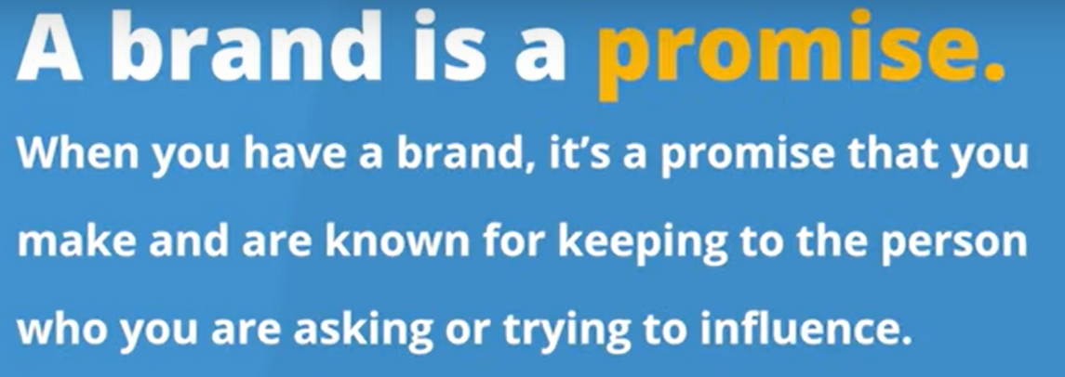
Brand Definition

Slide 5
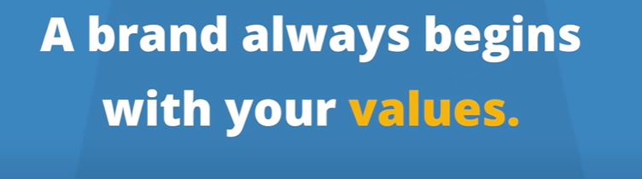
How mind Working
Humans define emotionally
Justify logically
Better personal Brand better paycheck,

Slide 6
How mind Works
Quality
Skills
Trust
Work Ethics
Education
Responsiveness
Teamwork
Innovation
Creativity
Leadership
Do you fulfill your promises

Slide 7
Law of Brand

Slide 8
Law of Branding
Specialization – focus on one area of achievement
Your skills might be diverse, but you focus on one goal
Leadership – you need to be recognized and acknowledged as one of the most skilled people in your field
Personality – includes your successes, failures, and flaws
What will be a good way for people to describe you

Slide 9
Law of Branding
Distinctiveness – express your brand in a unique way
How people will remember you
Dress in a particular style
Sing a piece of paper with a special pen
Visibility – a personal brand must be seen repeatedly and consistently
Networking
Volunturing

Slide 10
Law of Branding
Utility – your behavior after closed doors should match your public brand
Online posting
Online behavior
Exposure to your personal life
Interaction with public
Persistence – being consistent, give it time to grow
QoodWill – positivity, opportunities, professionalism

Slide 11
Benefits

Slide 12
Benefits
Getting faster promotions
Getting to be noticed more often
Ensure networking
Building your reputation
Getting a higher salaries
Building your reputation

Slide 13
Build Brand

Slide 14
Steps
What is your goal – Finding a job
What type of position
Yesr of experience
Do you have prior experience
Level of education
Are you transitioning between one to another position

Slide 15
Steps
Ger clear on what you want to be known for
How do you want people will describe you
What do you do?
What are your hobbies
What are the things that make you unique
Recognitions
Project that you developed

Slide 16
Steps
Any specific talents that you have
Sport /Music / Art/Cooking
Travelling
Work related
Completions

Slide 17
Steps
Any specific talents that you have
Sport /Music / Art/Cooking
Travelling
Work related
Completions
What do you know more about the most people

Slide 18
Target Industry / Audience
Goal of your brand
Who is the target people to whom you are targeting your skills
What companies you are targeting
What skills do you are offering

Slide 19
Online Presence
Brand online
Social Media
GitHub
Personal website
Select your platform
Video channels
Intigram
Twitter

